Slide 1

Deploying Interactive Machine Learning Applications with Clipper
Joseph E. Gonzalez
Co-director of the RISE Lab jegonzal@cs.berkeley.edu

Slide 2
Managing the Machine Learning Lifecycle
Joseph E. Gonzalez
Co-director of the RISE Lab jegonzal@cs.berkeley.edu

Slide 3
About Me
Co-director of the RISE Lab
Co-founder of Turi Inc.
Member of the Apache Spark PMC
Research
Artificial Intelligence
Data Science
Distributed Data Systems
Graph Processing Systems

Slide 4
Conjecture
Machine learning models are the next “big data”
Evidence
Corollary
Everyone is talking about models but few have them.
They have the opportunity to transform industries.
They are a consequence of mastering big data.
Today, their full value is only realized with advanced skills and technologies
We need new technologies to manage the machine learning lifecycle

Slide 5
Conjecture
Machine learning models are the next “big data”
Evidence
Corollaries
Everyone is talking about models but few have them.
They have the opportunity to transform industries.
They are a consequence of mastering big data.
Today, their full value is only realized with advanced skills and technologies
Data Engineers will need to manage data & machine learning models
We need new technologies to manage the machine learning lifecycle

Slide 6
What is the Machine Learning Lifecycle?

Slide 7
Identifying potential sources of data
Joining data from multiple sources
Addressing missing values and outliers
Plotting trends to identify anomalies
Help!

Slide 8
Identifying potential sources of data
Joining data from multiple sources
Addressing missing values and outliers
Plotting trends to identify anomalies
Help!
Happy to JOIN

Slide 9
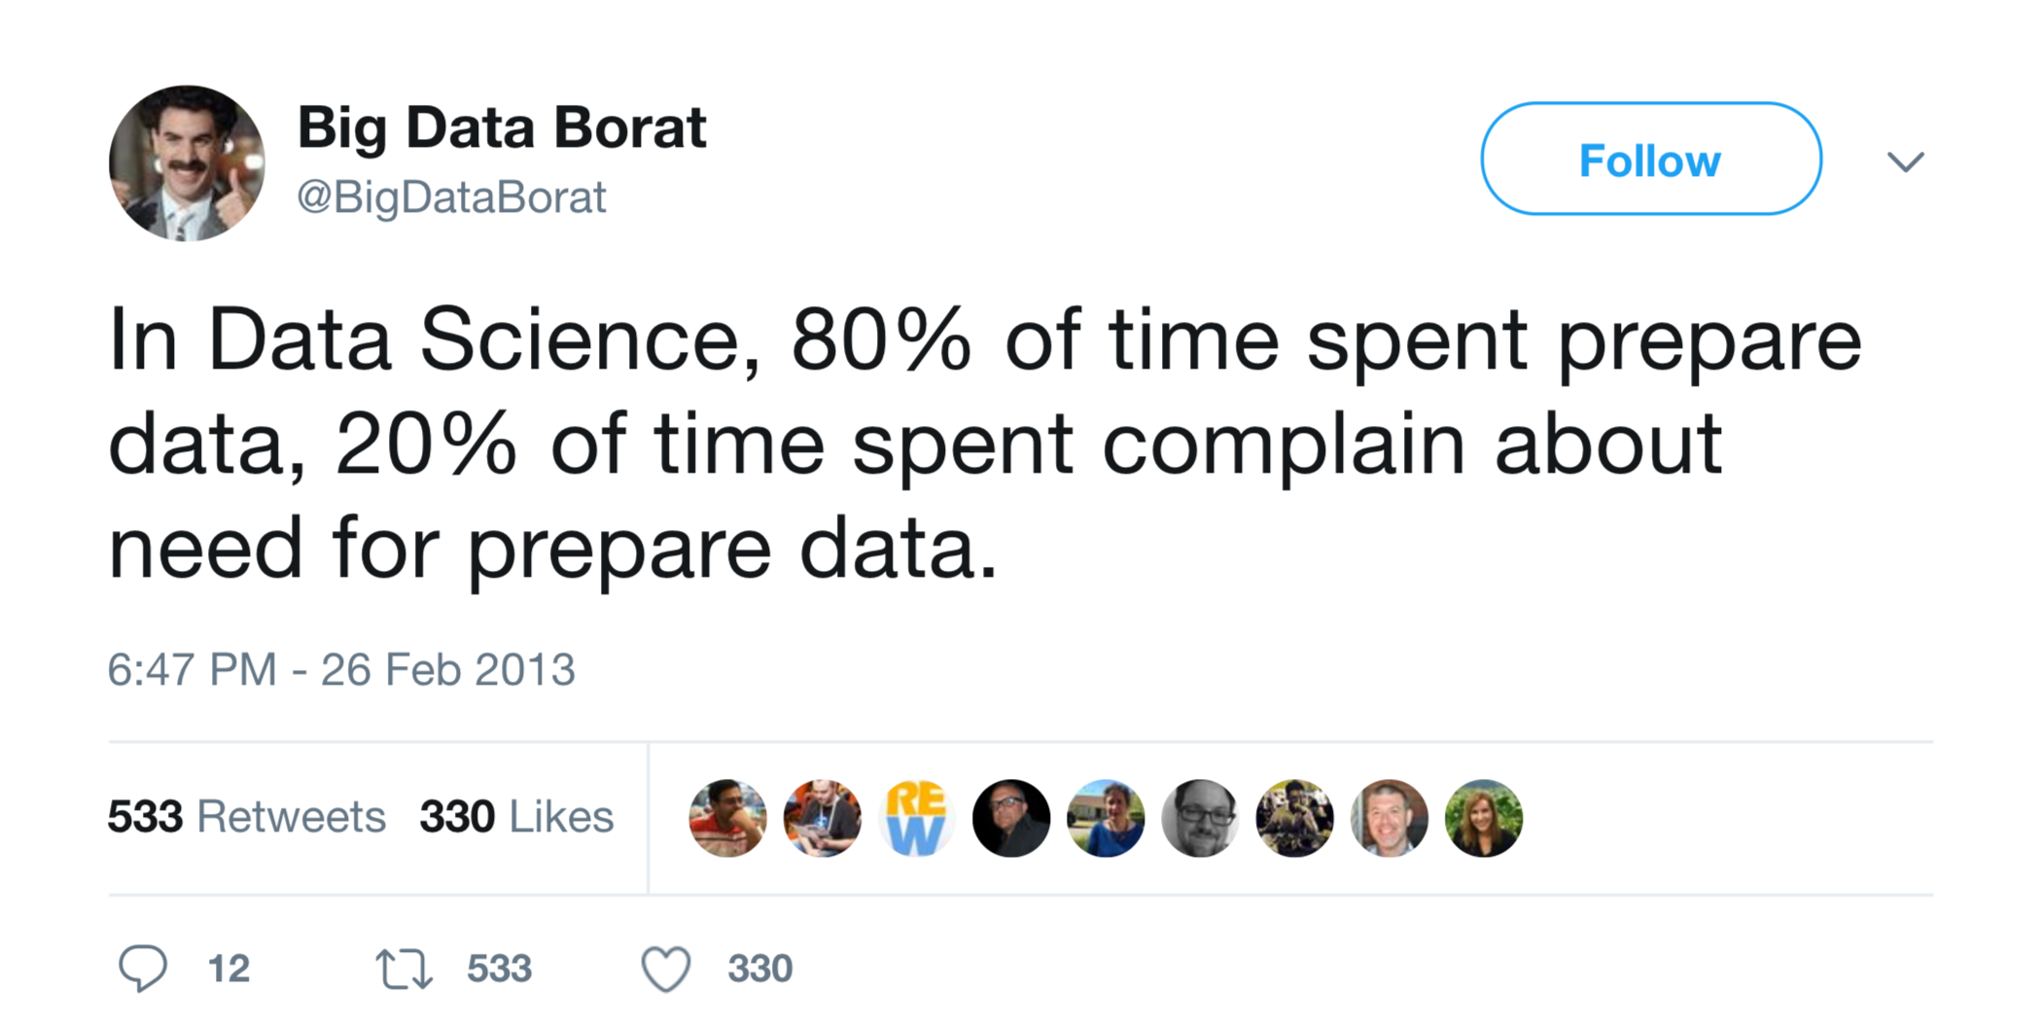

Slide 10
Identifying potential sources of data
Joining data from multiple sources
Addressing missing values and outliers
Plotting trends to identify anomalies
Help!
Happy to JOIN

Slide 11
Building informative features functions
Designing new model architectures
Tuning training algos.
Validating prediction accuracy
I was born for this!

Slide 12
Technologies

Slide 13
What is the output of
Reports & Dashboards
(insights …)
Trained Model

Slide 14
Reports & Dashboards
What is the output of
(insights …)
A learned function from a query to a prediction
Trained Model
“CAT”
consisting of parameters and model structure.
Data
(10B to 10GB)
How to use the parameters…

Slide 15
What is the output of
Reports & Dashboards
(insights …)
Trained Model
Bad Idea

Slide 16
What is the output of
Why is it a Bad Idea to directly produce trained models from model development?
With just a trained model we are unable to
retrain models with new data
track data and code for debugging
capture dependencies for deployment
audit training for compliance (e.g., GDPR)
Trained Models

Slide 17
What is the output of
Reports & Dashboards
(insights …)
Trained Models
Bad Idea

Slide 18
What is the output of
Reports & Dashboards
(insights …)
Training Pipelines

Slide 19
Training Pipelines Capture the Code and Data Dependencies
Description of how to train the model from data sources
Training Pipelines
Trained
Models
Training Data
Software Engineering
Analogy
Training Pipelines → Code
Trained Models → Binaries

Slide 20
What is the output of
Reports & Dashboards
(insights …)
Training Pipelines

Slide 21
What is the output of

Slide 22
Training models at scale on live data
Retraining on new data
Automatically validate prediction accuracy
Manage model versioning
Requires minimal expertise in machine learning

Slide 23
Technologies
Workflow Management:
Apache
Airflow
Scalable Training:

Slide 24
Open Problems
Context
& Composition

Slide 25
How, What, & Who?
Context
How was the model or data created?
What is the latest or best version?
Who is responsible? (blame...)
Track relationships between
Code versions
Model & Data versions
People (versions?)
Partial
Solution
✓
Training Pipelines

Slide 26
Composition
Models are being composed to solve new problems
Cuteness Detector
Cute!

Slide 27
Composition
Models are being composed to solve new problems
Puppy
Detector
Yes
Cuteness Detector
Cute!
Ball Detector
Yes

Slide 28
Composition
Models are being composed to solve new problems
Puppy
Detector
Wrong but helpful…
Yes
Cuteness Detector
Still Correct
Cute!
Ball Detector
Yes
Notes:
composition

Slide 29
Composition
Models are being composed to solve new problems
Puppy
Detector
Wrong but helpful…
Yes
Cuteness Detector
Still Correct
Cute!
Ball Detector
Yes

Slide 30
Composition
Models are being composed to solve new problems
Puppy
Detector
Reasonable Improvement
No
Cuteness Detector
Not Cute!
Ball Detector
Degradation in accuracy
Yes
Notes:
fasdf

Slide 31
Composition
Models are being composed to solve new problems
Need to track composition and validate end-to-end accuracy.
Puppy
Detector
Reasonable Improvement
Need unit and integration testing for models.
No
Cuteness Detector
Not Cute!
Ball Detector
Degradation in accuracy
Yes
Notes:
fasdf

Slide 32
Active Research in the for Model Development and Training
flor
A an open source context management service
that spans multiple data systems
http://www.ground-context.org/
An experiment management designed to track data, code, and people and address reproducibility
https://github.com/ucbrise/flor

Slide 33
What is the output of

Slide 35
Goal: make predictions in ~10ms under heavy load
Complicated by Deep Neural Networks ➔ New ML Algorithms and Systems

Slide 36

Technologies

Slide 37
Technologies
Our system →
Specialized in Particular Models or Frameworks

Slide 38
Deploying Interactive Machine Learning Applications with Clipper
Joseph E. Gonzalez
Co-director of the RISE Lab jegonzal@cs.berkeley.edu

Slide 39
The remainder of this talk …
Challenges of prediction serving
Clipper architecture overview
Open-source system effort
Notes:
”Abstract away the model behind a uniform API”

Slide 40


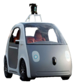





Prediction-Serving Challenges
???
VW
Caffe
40
Support low-latency, high-throughput serving workloads
Large and growing ecosystem of ML models and frameworks

Slide 41
Support low-latency, high-throughput serving workloads
Models getting more complex
10s of GFLOPs [1]
Deployed on critical path
Maintain SLOs under heavy load
Using specialized hardware for predictions
[1] Deep Residual Learning for Image Recognition. He et al. CVPR 2015.
Notes:
FLOPs, numbers for models,

Slide 42
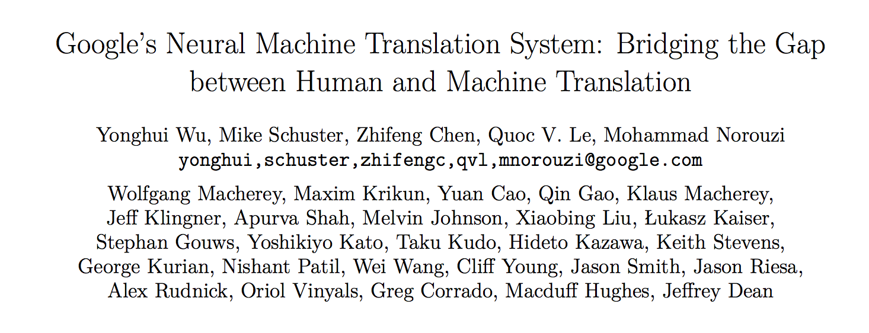
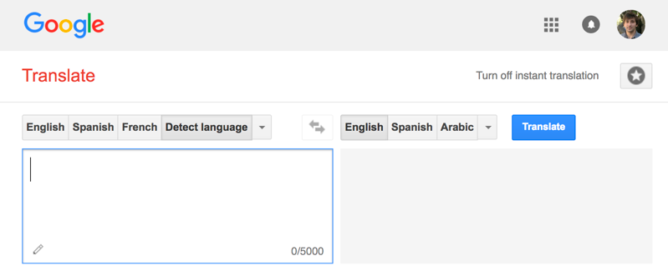
Google Translate
Serving
“If each of the world’s Android phones used the new Google voice search for just three minutes a day, these engineers realized, the company would need twice as many data centers.” – Wired
140 billion words a day¹
Designed New Hardware!
Tensor Processing Unit (TPU)
82,000 GPUs running 24/7
[1] https://www.nytimes.com/2016/12/14/magazine/the-great-ai-awakening.html
Notes:
Model scoring that drove Google to develop new hardware, not training
Mention Paul Barham’s talk

Slide 43

Building Application Specific Systems

Slide 44
Building Application Specific Systems
Problems:
Expensive to build and maintain
Require ML and systems expertise
Tightly-coupled model and application
Difficult to change or update application
Only supports single ML framework

Slide 45
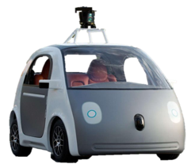






Growing ecosystem of ML Frameworks
Fraud Detection
Content
Rec.
Personal
Asst.
Robotic
Control
Machine
Translation
???
VW
Caffe
Notes:
Different models, different frameworks have different strengths
Give example of why all are needed
Multiple applications with different needs within an org
Even a single application may need to support multiple frameworks

Slide 46
Building & maintaining separate serving systems
for each framework
is expensive!
Solution
Pre-materialize predictions into a low latency Data Management System

Slide 47
Pre-materialized Predictions

Slide 48
Pre-materialized Predictions
Batch Training Framework
All Possible
Queries

Slide 49
Pre-materialized Predictions
Data Management System
Batch Training Framework
(Scoring)
All Possible
Queries

Slide 50
Pre-materialized Predictions
Data Management System
Batch Training Framework
(Scoring)
All Possible
Queries
Standard Data Eng. Tools

Slide 51
Serving Pre-materialized Predictions
Data Management System
Query
Batch Training Framework
(Scoring)
Decision
All Possible
Queries
Application
Low-Latency Serving
Standard Data Eng. Tools

Slide 52
Serving Pre-materialized Predictions
Data Management System
Problems:
Requires full set of queries ahead of time
Small and bounded input domain
Requires substantial computation and space
Example: scoring all content for all customers!
Costly update → rescore everything!
Query
Batch Training Framework
(Scoring)
Decision
All Possible
Queries
Application
Low-Latency Serving

Slide 53
Wide range of application and frameworks
???
VW
Caffe
53
Notes:
Different models, different frameworks have different strengths
Give example of why all are needed
Multiple applications with different needs within an org
Even a single application may need to support multiple frameworks

Slide 54
Middle layer for prediction serving.
Common Abstraction
System
Optimizations
VW
Caffe

Slide 55


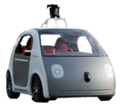





Clipper Decouples Applications and Models
Applications
Predict
RPC/REST Interface
Observe
Clipper
RPC
RPC
RPC
RPC
Model Container (MC)
MC
MC
MC
Caffe
VW
Notes:
Clipper interposes itself in the middle , decouples applications and models with a narrow waist prediction serving API.

Slide 56
Clipper Decouples Applications and Models
Applications
Predict
RPC/REST Interface
Observe
Clipper
Core system: 10K lines of C++ and 8K lines of Python
Open Source (Apache License) – http://clipper.ai
Designed to support production level query traffic
Deliver low + predictable latency
Research goal: study reality …
VW
RPC
RPC
RPC
RPC
Create
Model Container (MC)
MC
MC
MC
Caffe
Model Container
Model Container
Notes:
Clipper interposes itself in the middle , decouples applications and models with a narrow waist prediction serving API.

Slide 57






Clipper Implementation
clipper
admin
Applications
Predict
Clipper
Clipper
Management
Query Processor
Prometheus
Monitoring
Redis
ConfigDB
Model Container
Model Container

Slide 58




Run alongside other applications with Kubernetes
Web Server
Other applications
Other applications
Clipper
Cache
Query Processor
Other applications
Database
Other applications
Model Container
Model Container

Slide 59
Getting Started with Clipper
Tutorials at http://clipper.ai
Docker images available on DockerHub
Clipper admin is distributed as pip package:
pip install clipper_admin
Get up and running without compiling
Notes:
so all you need to do to launch a Clipper cluster is pip install

Slide 60
Clipper Design Innovations
Containerized frameworks: unified abstraction and framework level isolation and scaling
Cross-framework caching and batching: optimize throughput and latency
Cross-framework model composition: improved accuracy through ensembles and bandits
Notes:
”Abstract away the model behind a uniform API”

Slide 61



Clipper Architecture
Applications
Predict
RPC/REST Interface
Feedback
Clipper
RPC
RPC
RPC
RPC
Model Container (MC)
MC
MC
MC
Caffe
VW
Create

Slide 62
Clipper Architecture
Applications
Predict
RPC/REST Interface
Feedback
Clipper
RPC
RPC
RPC
RPC
Model Container (MC)
MC
MC
MC
Caffe
VW
Create
Common Interface → Simplifies Deployment:
Evaluate models using original code & systems

Slide 63
Container-based Model Deployment
Implement Model API:
class ModelContainer:
def __init__(model_data)
def predict_batch(inputs)
API support for many programming languages
Python
Java
C/C++
R
Notes:
Data scientist doesn’t have to learn any new skills

Slide 64
Container-based Model Deployment
Package model implementation and dependencies
Model Container (MC)
class ModelContainer:
def __init__(model_data)
def predict_batch(inputs)
VW
Create

Slide 65
Clipper Decouples Applications and Models
Applications
Predict
RPC/REST Interface
Feedback
Clipper
RPC
RPC
RPC
RPC
Model Container (MC)
MC
MC
MC
Caffe
VW
Create
Common Interface → Simplifies Deployment:
Evaluate models using original code & systems
Models run in separate processes as Docker containers
Resource isolation: ML frameworks can be buggy

Slide 66
Clipper Decouples Applications and Models
Applications
Predict
RPC/REST Interface
Feedback
Clipper
RPC
RPC
RPC
RPC
RPC
RPC
Model Container (MC)
MC
MC
MC
MC
MC
Caffe
Common Interface → Simplifies Deployment:
Evaluate models using original code & systems
Models run in separate processes as Docker containers
Resource isolation: ML frameworks can be buggy
Scale-out at the level of individual models

Slide 67
Clipper Architecture
Applications
Predict
RPC/REST Interface
Observe
Clipper
RPC
RPC
RPC
RPC
Model Container (MC)
MC
MC
MC
Caffe
Notes:
Clipper interposes itself in the middle , decouples applications and models with a narrow waist prediction serving API.

Slide 68




Clipper Architecture
Applications
Predict
RPC/REST Interface
Observe
Clipper
Model Selection Layer
Combine predictions across frameworks
Model Abstraction Layer
Provide a common interface and system optimizations
RPC
RPC
RPC
RPC
Model Container (MC)
MC
MC
MC
Caffe
Notes:
because model-abstraction layer lets you plug in many models, model selection layer chooses between them
introduce learning in selection layer later

Slide 69
Clipper Architecture
Applications
Predict
RPC/REST Interface
Observe
Optimized Batching
Clipper
Common
API
Model
Isolation
Caching
Model Selection Layer
Combine predictions across frameworks
Model Abstraction Layer
Provide a common interface and system optimizations
RPC
RPC
RPC
RPC
Model Container (MC)
MC
MC
MC
Caffe
Notes:
because model-abstraction layer lets you plug in many models, model selection layer chooses between them
introduce learning in selection layer later

Slide 70
Batching to Improve Throughput
Why batching helps:
Optimal batch depends on:
hardware configuration
model and framework
system load
A single
page load may generate
many queries
Throughput-optimized frameworks
Throughput
Batch size
Notes:
Make clearer that batching navigates tradeoff between throughput and latency

Slide 71
Batching to Improve Throughput
Latency-aware
Why batching helps:
Optimal batch depends on:
hardware configuration
model and framework
system load
A single
page load may generate
many queries
Clipper Solution:
Adaptively tradeoff latency and throughput…
Inc. batch size until the latency objective is exceeded (Additive Increase)
If latency exceeds SLO cut batch size by a fraction (Multiplicative Decrease)
Throughput-optimized frameworks
Throughput
Batch size
Notes:
Make clearer that batching navigates tradeoff between throughput and latency

Slide 72
Tensor Flow Conv. Net (GPU)
Better
Throughput (Queries Per Second)
Batch Size
Notes:
Two plots, thorughput on top, latency on bottom

Slide 73
Tensor Flow Conv. Net (GPU)
Better
Throughput (Queries Per Second)
Latency (ms)
Better
Batch Size
Notes:
Two plots, thorughput on top, latency on bottom

Slide 74
Tensor Flow Conv. Net (GPU)
Better
Throughput (Queries Per Second)
Optimal Batch Size
Latency (ms)
Better
Batch Size
Notes:
Two plots, thorughput on top, latency on bottom

Slide 75
Batching to Improve Throughput
Latency-aware
Better
Throughput
(QPS)

Slide 76


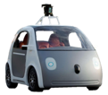

Overhead of decoupled architecture
Applications
Applications
Predict
RPC Interface
Predict
RPC/REST Interface
Feedback
TensorFlow-Serving
Clipper
RPC
RPC
RPC
RPC
MC
MC
MC
MC
Caffe
Notes:
adopts a more monolithic architecture with both the serving and model-evaluation code in a single process

Slide 77
Overhead of decoupled architecture
Better
P99 Latency
(ms)
Throughput
(QPS)
Better
TensorFlow Serving
Clipper
TensorFlow Serving
Clipper
Decentralized system matches performance of centralized design.
Notes:
Model: AlexNet trained on CIFAR-10

Slide 78
Clipper Architecture
Applications
Predict
RPC/REST Interface
Observe
Clipper
Model Selection Layer
Combine predictions across frameworks
Model Abstraction Layer
Provide a common interface and system optimizations
RPC
RPC
RPC
RPC
Model Container (MC)
MC
MC
MC
Caffe
Notes:
because model-abstraction layer lets you plug in many models, model selection layer chooses between them
introduce learning in selection layer later

Slide 79
Clipper Architecture
Applications
Predict
RPC/REST Interface
Observe
Clipper
Model Selection Layer
Combine predictions across frameworks
Model Abstraction Layer
Provide a common interface and system optimizations
RPC
RPC
RPC
RPC
Model Container (MC)
MC
MC
MC
Caffe
Notes:
because model-abstraction layer lets you plug in many models, model selection layer chooses between them
introduce learning in selection layer later

Slide 80
Clipper Architecture
Applications
Predict
RPC/REST Interface
Observe
Clipper
Model Selection Layer
Combine predictions across frameworks
Model Abstraction Layer
Provide a common interface and system optimizations
Version 1
Periodic retraining
Version 2
Version 3
RPC
RPC
RPC
RPC
Model Container (MC)
MC
MC
MC
Caffe
Experiment with new models and frameworks
Caffe
Notes:
because model-abstraction layer lets you plug in many models, model selection layer chooses between them
introduce learning in selection layer later

Slide 81
Selection Policy can Calibrate Confidence
Version 2
Version 3
“CAT”
“CAT”
UNSURE
“DJ”
Policy
“CAT”
“CAT”
Caffe

Slide 82
Selection Policy: Estimate confidence
Better
Notes:
put best model accuracy back in

Slide 83
Selection Policy: Estimate confidence
Better
width is percentage of query workloads

Slide 84
Project Status and Development
Current development focus:
stability and performance improvements
easy model deployment for common ML frameworks: Pytorch, caffe2 (via onnx), tensorflow, xgboost, mxnet, pyspark, scikit learn
metrics and monitoring infrastructure using Prometheus
Development Team: 22 active contributors
Including 8 from outside Berkeley
Working with several organizations on production deployments
SAP, Scotia Bank, Pacific AI, ARM…

Slide 85
I made a case for
Model &
Data Engineering
and outlined some of the opportunities & challenges

Slide 86

Machine Learning Lifecycle

Slide 87
http://clipper.ai
Open-source prediction serving system for
low-latency, high-throughput predictions across machine learning models and frameworks.

Slide 88





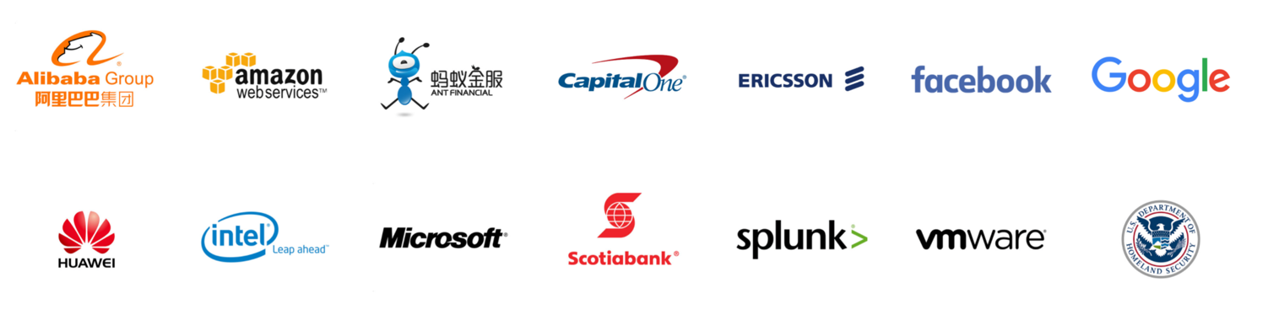
Thank you!
jegonzal@berkeley.edu
Collaborators
Daniel
Crankshaw
Rolando
Garcia
Joe
Hellerstein
Yika
Luo
Simon
Mo
Vikram
Sreekanti
Ion Stoica
Alexey
Tumanov
Xin
Wang
Neeraja
Yadwadkar
Corey
Zumar
Research Sponsors

Slide 89
Bonus!

Slide 90
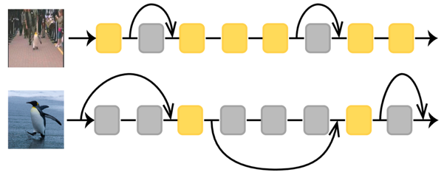
A few of the RISE Lab projects …
Real-time Inference
Teaching AI to think fast by learning not to overthinking
Clipper
SkipNets: RL for Dynamic Network Design
AutoPyLot
Hardware Security for
Apache Spark
An open platform for Autonomous Vehicles
Parallel Python for Reinforcement Learning

Slide 91
Ray Tune

Slide 92
RL and Deep Learning workloads demand different resource requirements.
CPU
CPU
CPU
CPU
GPU
GPU
GPU
CPU
CPU
GPU
GPU
GPU
GPU
GPU
GPU
GPU
GPU
Logistic Regression
Deep Learning
Deep Reinforcement Learning

Slide 93
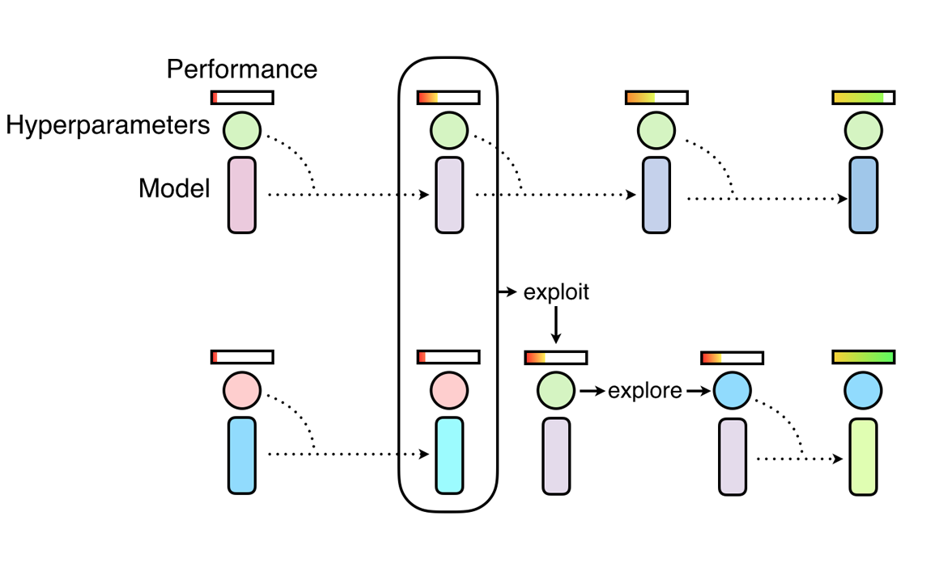
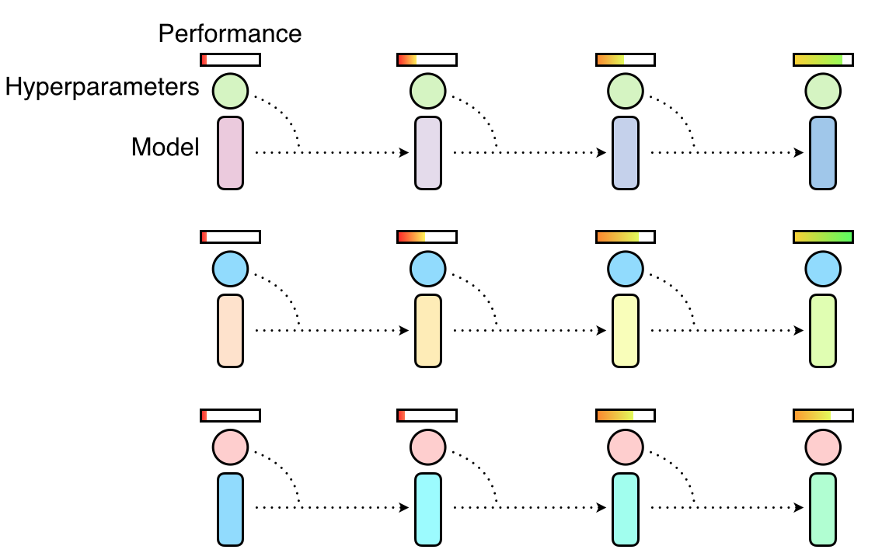
New Algorithms for hyperparameter tuning require more complicated control flows
Population Based Training
HyperBand

Slide 94





Ray Tune
CPU
GPU
CPU
GPU
CPU
GPU
CPU
GPU
Notes:
Supports traditional algorithms such as Bayesian Optimization
Supports any framework - Keras, TF,
Naturally integrates distributed execution with hyperparameter search - go from 1 to many machines without changing your code

Slide 95
Security

Slide 96


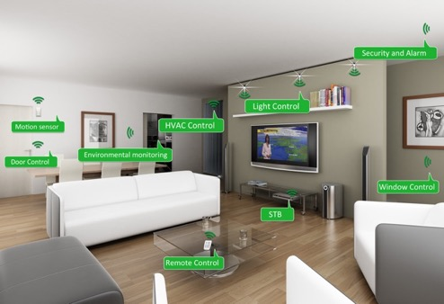
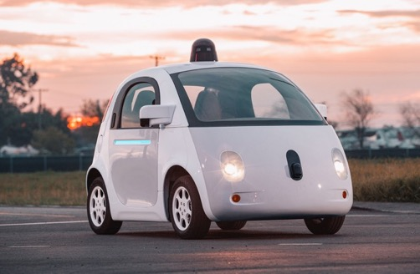
Machine Learning is on the critical path
Augmented Reality
Home Security
Home Automation
Mobile
Assistants
Self Driving Cars
Personal Robotics

Slide 97


Machine Learning in Sensitive Contexts
AR/VR Systems
Home Monitoring
Voice Technologies
Medical Imaging
Protect the data, the model, and the query

Slide 98

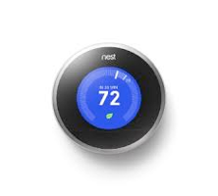
Protect the data, the model, and the query
High-Value Data is Sensitive
Medical Info.
Home video
Finance
Models capture value in data
Core Asset
“Contain” the data
Data
Queries can be as sensitive as the data

Slide 99
Dynamic Inference

Slide 100
Model costs are increasing much faster than gains in accuracy.
Small
but significant
Order of magnitude gap
Complexity →
Complexity →
Notes:
Imagenet Top One accuracy

Slide 101

Dynamic Networks Learning Not to Overthink
IDK Prediction Cascades
Query
Simple Model
I don’t
Know
Accurate Model
Fast
Slow
Prediction
Prediction
SkipNets: gated execution
Easy Images Skip Many Layers
Hard Images
Skip Few Layers

Slide 102


IDK
Prediction
Cascades
Simple models for simple tasks
Xin
Wang
Yika
Luo
Zi-Yi
Duo
Fisher
Yu
Simple Model
I don’t
Know
Accurate Model
Query
Fast
Slow
Prediction
Prediction
Learn to combine fast (inaccurate) models with slow (accurate) models to maximize accuracy while reducing computational costs.

Slide 103
Simple Model
I don’t
Know
Accurate Model
Query
Fast
Slow
Prediction
Prediction
SkipNet: dynamic execution within a model
Query
Prediction
Conv
Conv
Conv
Conv
Gate
Conv
Conv
Gate
Conv
FC

Slide 104
Simple Model
I don’t
Know
Accurate Model
Query
Fast
Slow
Prediction
Prediction
SkipNet: dynamic execution within a model
Query
Prediction
Conv
Conv
Conv
Conv
Gate
Conv
Conv
Gate
Conv
FC
Skip Blocks

Slide 105
Simple Model
I don’t
Know
Accurate Model
Query
Fast
Slow
Prediction
Prediction
SkipNet: dynamic execution within a model
Query
Prediction
Conv
Conv
Conv
Conv
Gate
Conv
Conv
Gate
Conv
FC
Skip Blocks
Combine reinforcement learning with supervised pre-training to learn a gating policy

Slide 106
SkipNet Performance
Easy Images Skip Many Layers
Hard Images
Skip Few Layers

